Slide 1
Researching Careers in the Humanities & Social Sciences
Sherri Brown
GT Library
Spring 2014

Slide 2
Career Resources: Questions to Consider
What kind of information does your resource provide?
Who might find this useful? Would you use this for your career research, why or why not?
What would you change or add to make the resource more useful?

Slide 3
Researching Careers Overview
Networking
Career Services
Libraries
Career-related Web sites
Employers
Professional Societies & Associations

Slide 4

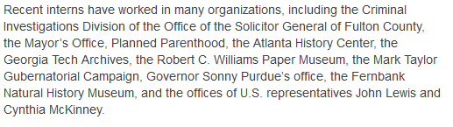
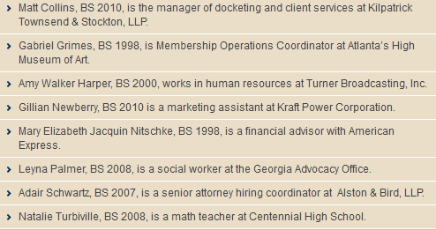
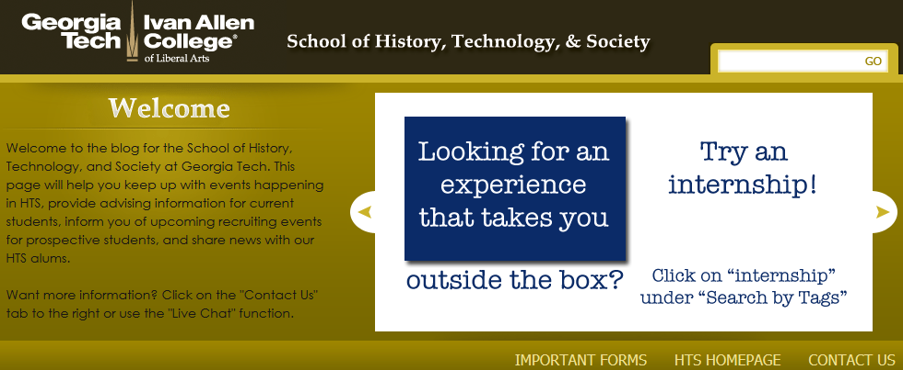
Networking
Friends & Family
Alumni
Professors & Advisors

Slide 5

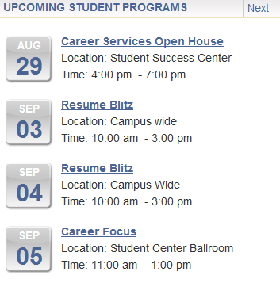


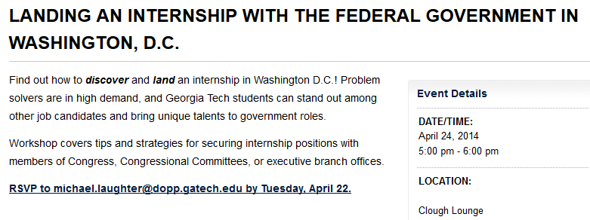
Career Services
Career Counselors
Career Fairs & Seminars
Employer Information Sessions
Employment / Job Links
Career & Job Search Advice

Slide 6




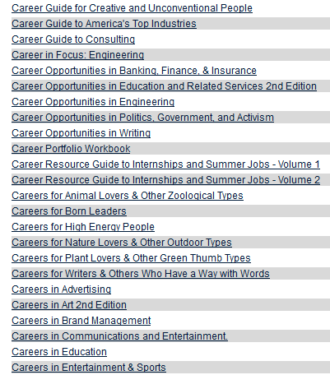



Career Services
Career Research Tools
Career Library
Salary Calculator Tools

Slide 7







Libraries
Research Guides
  Careers
  Company Information

Slide 8
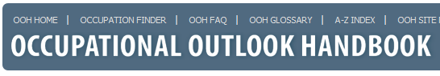
Career-related Websites
Sections
Nature of Work (What They Do)
Work Environment
Training & Advancement (How to Become One)
Earnings (Pay)
Job Outlook
Similar Occupations
Contacts for more Info
U.S. Dept. of Labor
Revised every two years
Beginning 2012-13 online only
  projections 2012-2022
  334 occupational profiles
  580 detailed occupations covered

Slide 9





Career-related Websites
Occupation Profiles
Wages & Trends
Industry Info
O*NET online

Slide 10

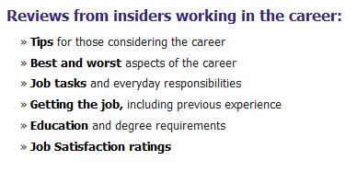


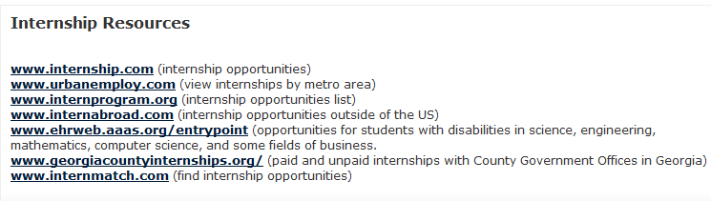
Career-related Websites

Slide 11


Employers
Informational Interviews
Internships
Research Opportunities
Company Info Sites – Databases or direct sites

Slide 12











Professional Societies & Associations

Slide 13
Questions?
Contacts: sherri.brown@library.gatech.edu
Subject Librarians

